Slide 1
Fiscal Policies Committee & the Budget Process
Manuel Correia, Amy Denton, Scott Frisch,
Sean Kelly, Claudio Paiva, Janet Pinkley, Greg Wood

Slide 2
Committee Charge
Per the By-Laws of the Academic Senate
the charge of the Fiscal Policies Committee is to “review the University’s annual budget” and make “policy recommendations concerning the optimum utilization of resources in the achievement of university academic objectives.”

Slide 3
Intent to Raise Questions
To comply with this charge we require information from the major divisions of the university. Through the office of the Provost the Fiscal Policies Committee has requested information from each of the major divisions of the university regarding the use of university resources in their areas (questions available upon request).
Do you intend to supply the Fiscal Policies Committee of the Academic Senate with this information? If so, what is your timeline for doing so? If not, why do you refuse to provide the information necessary to carry out its charge according to the By Laws of this body?

Slide 4
Questions from the FPC

Slide 5
Staffing AY 2014-2015
On this slide present the following information:
How many full time staff/faculty are in your area?
How many of your staff/faculty are MPP/tenure track?
How many part-time staff/faculty are in your area?
How do these employees support the mission of the university?
How many student workers do you employ?
How does the work of students in your area support the mission of the university
* You may want to contact HR to help you collect these data

Slide 6
AY 2015-2016 Budget Requests
Highlight your requests for the NEXT academic year
What percentage increase/decrease do you anticipated compared to the last academic year?
How many staff positions will you request?
What major expenditures will you request?
What do you see as the major budget challenges next AY?
Be sure to discuss how these requests are related to the mission of the university (see slide 2)

Slide 7
Response

Slide 8
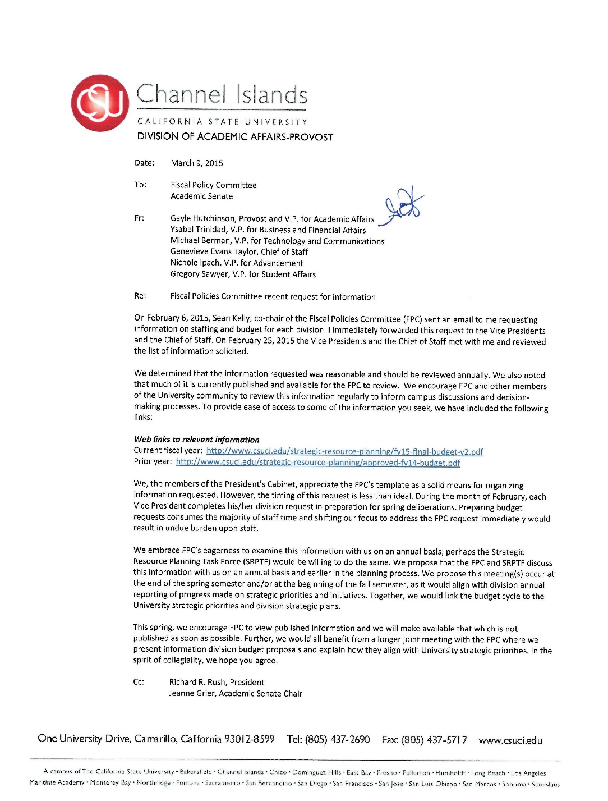
From what I could piece together, faculty salaries make up 10 percent of the budget. Tenure track salaries add to about 5 percent. Am I correct? (and should I have to be unsure about this?!) It seems a well-designed table should make that very clear…

Slide 10
Next Steps
Fiscal Policies cannot fulfill its charge without information sufficient to answer basic questions about the resource allocations of the university.
Next Steps
Requested a meeting with the President to discuss the charge of Fiscal Policies, and faculty voice in the budget process
Will discuss with WASC representatives our deep misgivings about faculty voice in budget process
Report to the Senate at its next scheduled meeting

