Slide 1
Faculty Affairs Committee
2nd Reading: RTP
1st Reading: Temporary Counselor Evaluation

Slide 2
RTP Policy
Brown bag: 4-10-18
Resubmitted w/ revisions

Slide 3
Tenure
Two factors:
Quality of performance
Length of time (6-year benchmark)

Slide 4
SP 17-XX
“The granting of tenure before the normal six (6) years of full-time probationary service and credited service (as specified in the CBA) is rare, but may be considered under exceptional circumstances.”

Slide 5
CBA
“Any deviation from the normal six (6) year probationary period shall be the decision of the President following his/her consideration of recommendations from the department or equivalent unit and appropriate administrator(s).”

Slide 6
“normal”
1. conforming to the standard or the common type; usual; not abnormal; regular; natural.
2. serving to establish a standard.

Slide 7
Early Tenure
“exceptional circumstances”
1. forming an exception or rare instance; unusual; extraordinary: 2. unusually excellent; superior

Slide 8
SP 17-XX
“Early tenure is normally reserved for those whose accomplishments have brought widespread recognition to the individual and the University from the academic community and/or the general public.”
“In addition, the granting of early tenure requires that all expectations for the entire probationary period, as stated in the Program Personnel Standards, and confirmed by the PPC and the URTPC, have been met.”

Slide 9
SP 17-XX
“Finally, the length and breadth of the applicant’s entire record—including, when appropriate, at the rank of lecturer for former CSUCI temporary faculty appointed as tenure-track assistant professors—may be considered so as to determine the likelihood that prior patterns of achievement and contribution will be sustained if early tenure is granted.”

Slide 10
Other point
Prior
Current
“Scores achieved during retention reviews during the probationary period shall not imply that similar scores will be achieved when applying for tenure [promotion]. In other words, each RTP evaluation score is discrete in nature.”
“Scores achieved during retention reviews during the probationary period shall not imply that similar scores will be achieved when applying for tenure. In other words, each RTP evaluation score is not necessarily predictive of future scores.”

Slide 11
Early Tenure: SP 15-15
“Early tenure requires that all expectations for the entire probationary period have been met and that performance in two areas be rated at ‘4— Exceeds Standards of Achievement’—for teaching faculty, one of these must be in the category of Teaching (professional activities for librarians and counselors)—and one category at least ‘3—Meets Standards of Achievement’ as stated in this document and Program Personnel Standards.”

Slide 12
Other substantive changes
WPAF: digital transition
Review calendar: starts in year 2
PPC: one per program

Slide 13
Temporary Counselor Evaluation
Current Policy: SP 15-11
Lecturer Evaluation Policy didn’t apply
AY 16-17: problems
“Direct” vs. “Indirect” services
“temporary counselor faculty shall be evaluated largely based on the provision of Direct Clinical Services (60-65% expectation) and Indirect Services (35-40% expectation)”

Slide 14
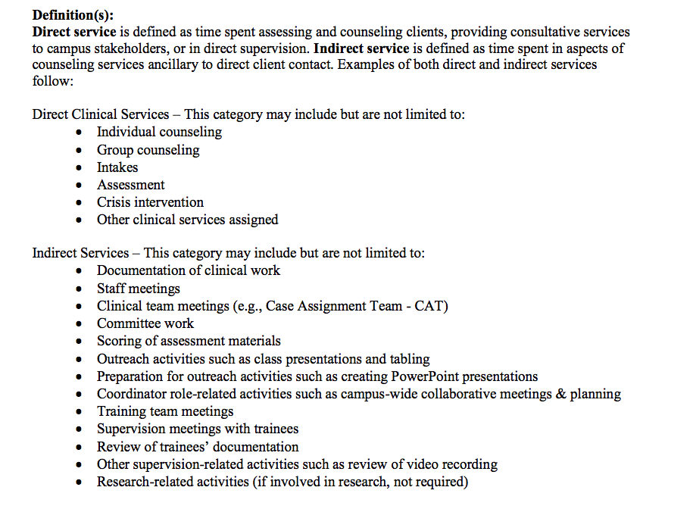

Slide 15
Changes
Removed definitions of “direct” vs. “indirect”
Overlap; director make determinations
Faculty committee review criteria:
Job description, responsibilities, expectations and qualifications along with the narrative & evidence provided

Slide 16
Changes
Accountability: Appropriate administrator in F.A., (Chair of Psychology)
F.A. administrator and Director of CAPS to identify peer-level committee
Evaluation process: Omit requirement to distinguish “direct” vs. “indirect” service
Evaluation process: other documentation: current job description, evidence of fulfillment of job requirements and work accomplished; any other evidence deemed appropriate

Slide 17
Changes
Evaluation Form:
Eliminate requirement to distinguish “direct” vs. “indirect”
Focus on expectations, qualifications, job description, and specific responsibilities.

