Slide 1
SP 15-15 / SP 17-xx UNIVERSITY RETENTION, TENURE, & PROMOTION POLICY
Highlights of Changes Proposed Faculty Affairs Committee

Slide 2
Worked on During 2016-17
WPAF
Appointment
Period of Review

Slide 3
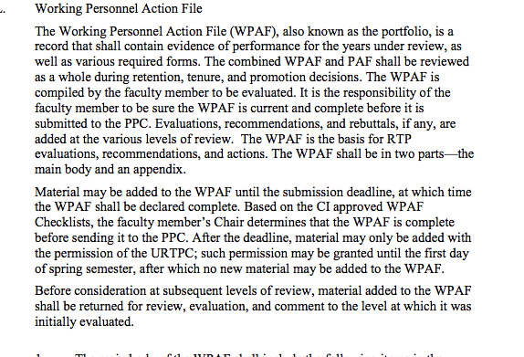
SP 15-15 (L):
Working Personnel Action File

Slide 4
SP 17-xx Proposal (K):
“The Working Personnel Action File (WPAF), also known as the portfolio…. Starting in academic year 2018-19, probationary faculty receiving a first performance review shall prepare an electronic WPAF for submission using the product selected by the campus. Other probationary faculty hired before academic year 2018-19 are strongly encouraged to use the electronic format for retention, tenure and promotion, but are not required to do so. Once moving to an electronic format, faculty may not return to paper submission in subsequent years. All faculty shall use electronic formats for WPAF materials by the 2023-24 academic year. It is the…”

Slide 5
SP 15-15: Appointment (G)
Normally, a probationary (tenure track) faculty member is given a two- year initial appointment.
All probationary faculty must be reviewed each year until tenured.
A review for reappointment, tenure, and/or promotion is a performance review. Any other review is a periodic review.
Probationary faculty with two year initial appointment shall have a periodic review in their first year of probation (or second or third year of probation if it is the first year of service at CI) and performance reviews before they are re-appointed to second, third, fourth, fifth, and sixth probationary years or are granted tenure. A performance review is also required for promotion.

Slide 6
SP 17-xx Proposal (F):
Normally, a probationary (tenure-track) faculty member is given a two-year initial appointment.
All probationary faculty must be reviewed after the first year of service until tenured.
A review for reappointment, tenure, and/or promotion is a performance review. Any other review is a periodic review.
Probationary faculty with a two-year initial appointment shall undergo performance reviews before they are reappointed to third, fourth, fifth, and sixth probationary years, or are granted tenure. A performance review is also required for promotion.

Slide 7
SP 15-15: Period of Review (K)
For reappointment, the period of review is the period since the last submission of the WPAF for reappointment.
For reappointment in the 3rd probationary year (or 4th for faculty hired with one or two years of prior service credit), the period of review is the entire probationary period, including years for which service credit is granted.
For tenure, the period of review is the entire probationary period, including years for which service credit is granted. For example, if a probationary faculty member received one year of service credit at the time of hire, they would begin at CI in their second probationary year.
For promotion, the period of review is the time spent in rank, including accomplishments during time spent at that rank at other four-year or graduate-degree granting institutions. For promotion of tenured faculty, the period of review is the time since tenure was granted.

Slide 8
SP 17-xx Proposal (J):
For reappointment, the period of review is the period since the last submission of the WPAF for reappointment.
During the first probationary year, faculty shall submit a PDP (see Section H) as well as at least one peer teaching observation (see Section K) in their second semester.
For reappointment in the 3rd probationary year (or 4th year for faculty hired with one or two years of prior service credit), the period of review is the entire probationary period, including years for which service credit is granted.
For tenure, the period of review is the entire probationary period, including years for which service credit is granted. For example, if a probationary faculty member received one year of service credit at the time of hire, they would begin at CSU Channel Islands in their second probationary year.
For promotion, the period of review is the time spent in rank, including accomplishments during time spent at that rank at other four-year or graduate-degree granting institutions. For promotion of tenured faculty, the period of review is the time since tenure was granted.

Slide 9
Worked on during 2017-18
Statement on Research eliminated
Constitution of PPC
Roles of administrators
Early Tenure

Slide 10
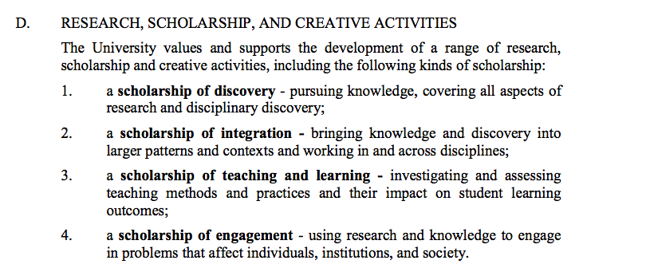
SP 15-15:

Slide 11
Proposal: Delete
Nothing similar on Teaching or Service
Such statements belong in PPS (see General Personnel Standards).
Vagueness and caveats (e.g., “a range of…”, “including…”, etc.)

Slide 12
SP 15-15 (F)
The Program Personnel Committee (PPC) shall be constituted as follows, in compliance with Article 15 of the CBA:
Every Program Personnel Standards document shall specify whether the PPC will be formed for the program as a whole or for individual faculty members under review.

Slide 13
SP 17-xx Proposal (E):
“Each academic year, the probationary and tenured faculty of each program or equivalent unit shall elect a three- or five-member Program Personnel Committee (PPC) of tenured faculty for the purpose of reviewing and recommending faculty who are being considered for retention, tenure, and promotion.”

Slide 14
SP 15-15:

Slide 15
SP 15-15:
for tenure or promotion decisions—the Provost/ Vice President for Academic Affairs (VPAA) [Vice President for Student Affairs (VPSA) for counselor faculty];
The Provost/ Vice President for Academic Affairs (VPAA) [Vice President for Student Affairs (VPSA) for counselor faculty], shall review retention files only if one or more of the following conditions apply:
a. requested by the President;
b. requested by faculty member under review;
c. requested by URTPC.
The President.

Slide 16
SP 17-xx Proposal (L):
The Provost/Vice President for Academic Affairs (VPAA) (Vice President for Student Affairs [VPSA] for counselor faculty) shall review all tenure and promotion files.
The Provost shall review all retention files as the President’s designee.
The President shall review all tenure and promotion files.

Slide 17
SP 15-15 (X):
Responsibilities of Provost
To review each tenure or promotion WPAF and recommend action to the President.
To provide copies of his/her recommendation and the basis for it to the faculty member.
To inform the faculty member of his or her right to response or rebuttal within ten (10) days.
To forward the WPAF to the President.

Slide 18
SP 17-xx Proposal (W):
Responsibilities of Provost
To review each WPAF file for retention.
To review each tenure or promotion WPAF and recommend action to the President.
To provide copies of his/her recommendation and the basis for it to the faculty member.
To inform the faculty member of his or her right to response or rebuttal within ten (10) days.

Slide 19
SP 15-15 (P):
Requirements for Tenure
“Early tenure requires that all expectations for the entire probationary period have been met and that performance in two areas be rated at “4— Exceeds Standards of Achievement”—for teaching faculty, one of these must be in the category of Teaching (professional activities for librarians and counselors)—and one category at least “3—Meets Standards of Achievement” as stated in this document and Program Personnel Standards.”

Slide 20
SP 17-xx Proposal (O):
“The granting of early tenure (for applications made before the times specified in the CBA) is rare, but may be considered under exceptional circumstances. Early tenure is reserved for those whose accomplishments have brought widespread recognition to the individual and the University from the academic community and/or the general public.”

Slide 21
SP 17-xx Proposal:
The granting of early tenure requires that performance in two areas be rated “5—Significantly Exceeds Standards of Achievement”)— one of which shall be in the category of Teaching (Professional Activities for librarians and counselors)—and that one category be rated at least “4—Exceeds Standards of Achievement” as stated in this document and the Program Personnel Standards.

Slide 22
SP 17-xx Proposal:
In addition, the granting of early tenure requires that all expectations for the entire probationary period, as stated in the Program Personnel Standards, and confirmed by the PPC and the URTPC, have been met. The length and breadth of the faculty member’s record prior to applying for early tenure shall be sufficient to provide a high expectation that the prior patterns of achievement and contribution will continue upon granting of early tenure.

Slide 23
Appendix B SP 15-15:
“Programs developing Personnel Standards shall make their PPS documents reflect the changing nature of CI, a start-up university.”

Slide 24
SP 17-xx Proposal:
“Programs developing Personnel Standards shall make their PPS documents consistent with the Mission of CSU Channel Islands.”

Slide 25
SP 15-15 (L):
Current wording:
“accomplishments in the areas of performance in teaching”

Slide 26
SP 17-xx Proposal
“accomplishments in Teaching”

