Slide 1
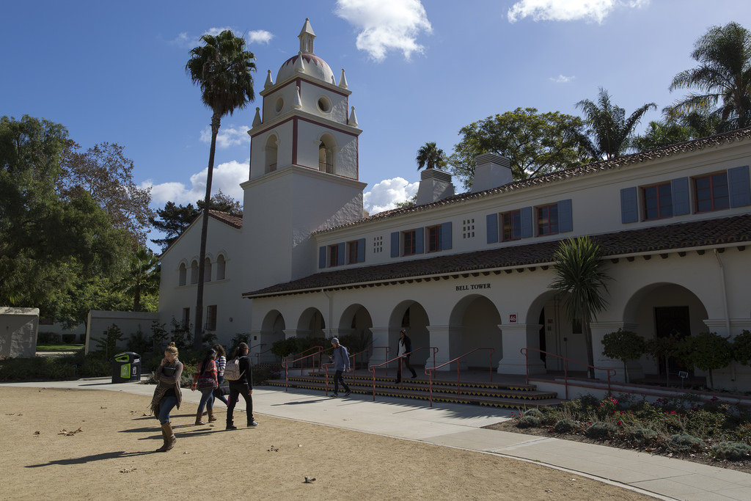
Academic Senate, 12/4
Intent to Raise Question

Slide 2
QUESTION
How can we change the Senate Committee voting process? How can the process be changed to include nominations and information about the candidates to help inform Senate member vote? What are the next steps to move forward to a new process?
Annie White
Academic Senate, 12.4.18
Intent to Raise Question

Slide 3
ANSWER
Senate Exec has forwarded this concern to the Faculty Affairs Cmte., a standing cmte. of the Academic Senate, and we hope to have the results of their consideration (a resolution? a policy?) before the close of the 'AY. That said, making faculty aware of this issue is one of our biggest hurdles and I thank Annie for bringing this to the attention of all of us. If your PPS requires some sort of specific service obligation, it might be a very good time to consider a review of the document.
It is also important to note that going forward, all committee elections will included a space for candidate statements.
Virgil Adams
Academic Senate, 12.4.18 Intent to Raise Question

Slide 4
QUESTION
My question: will a report summarizing the data, lessons learned, and questions remaining from the campus climate survey be shared in the near future?
Cindy Wyels
Academic Senate, 12.4.18
Intent to Raise Question

Slide 5
ANSWER
Last spring, President Beck launched a Climate Survey for our campus which closed at the end of the semester. Since its close, IRPE was decentralized to three Divisions and one of the previous members took a position at another campus.
Because of shortage of staff, a consultant has been hired to analyze the data and provide our campus with a summary report. The survey data is still being analyzed. As soon as it becomes available, we will disseminate to the campus.
Genevieve Evans-Taylor
Academic Senate, 12.4.18 Intent to Raise Question

Slide 6
QUESTION
Given the lack of faculty input on the change in hiring process, can faculty affairs work with faculty now to systematically evaluate the effects of these changes on our mission and culture?
Jules Balen
Academic Senate, 12.4.18
Intent to Raise Question

Slide 7
ANSWER
Faculty Affairs is more than willing to work with appropriate faculty to assess this change in recruiting procedures
Kent Porter
Academic Senate, 12.4.18 Intent to Raise Question

Slide 8
QUESTION
The Campus Reading Celebration with Roxanne Gay was a wonderful event, and a number of students bravely shared traumas and assaults they have endured. In conversation with some of them afterwards, faculty have learned that there are limits to the numbers of counseling appointments students can get. We would like to know what the process is to get a counseling appointment, why some students are allotted two and other six (for example), and in general how can we help students maximize the services available. An additional question is why do we hire only temporary counselors? This would seem to be a hindrance to hiring quality counselors to serve our students.
Marie Francois
Academic Senate, 12.4.18
Intent to Raise Question

Slide 9
ANSWER
Session Limits Part 1
The current CAPS Policies and Procedures Manual indicates that there is an 8-session limit. The manual predates my arrival in January 2018 and in speaking with CAPS staff, the number is not stated publicly and CAPS services are framed as providing short term/brief counseling. There are several reasons as to why the session limit is not explicitly communicated. First, the large majority of students who receive services from CAPS require far fewer sessions to stabilize their clinical symptomatology. Second, if students are informed of the 8-session limit, there is a tendency for students to expect that they will receive all 8 sessions, even if their clinical symptomatology does not require this. It is possible that when people hear short term or brief counseling, they imagine a hard session limit with a number attached. I’m not aware of any marketing/communication from CAPS staff related to specifying session limits in terms of a number. The CAPS Policies and Procedures Manual also provide guidance to assist clinicians in making determinations for continued/ongoing sessions vs. making a referral to an outside provider. Some considerations include the following: 1) client is making reasonable progress and could be expected to continue making gains (as opposed to progress being stalled or deteriorating); 2) presenting concern is situational crisis that can be managed within the scope of CAPS services; 3) an outside referral would be impractical; 4) new circumstances/information suggest a need for extended services (e.g., changes in support system; exacerbated environmental stressors).
Different students will receive a different number of sessions due to individual circumstances. Students that are seen for fewer sessions may be for a number of reasons: 1) student has made significant progress in a relatively short period of time; 2) student’s needs were determined to be outside the scope of CAPS services and a referral was made; 3) student may not want to engage in services.
.
Dr. Sean Kitaoka
Academic Senate, 12.4.18 Intent to Raise Question

Slide 10
ANSWER
Accessing Counseling Appointments Part 2
In terms of scheduling counseling appointments, students can call, email, or schedule in person for the first available appointment. In addition to scheduled appointments, CAPS provides same day crisis appointments every day from 12:30-4pm. In terms of maximizing the services that are available, the average wait time for AY 2017-2018 was 14.3 days for the first appointment. Any increased utilization would likely push the wait for a first appointment out further. Managing the increased demands on counseling service utilization is an issue on college campuses across the country.
Hiring Temporary Counselors
This may be a question beyond my experience. There are some CSU campuses that have tenured faculty counselors, but in speaking with other CSU CAPS Directors, the use of tenured faculty counselors is on the decline in favor of temporary faculty appointments. I don’t know the rationale for this and don’t know what the potential impact is on attracting, recruiting, and retaining high quality clinicians. The clinicians we’ve had have been a great group of professionals to work with
Dr. Sean Kitaoka
Academic Senate, 12.4.18 Intent to Raise Question

Slide 11
QUESTION
When a student tries to make an appointment with the counseling center and there aren't any available appointments, what is the procedure for making sure the student has access to services? And particularly, what is done when a student is in crisis and there are no available appointments?
Melissa Soenke
Academic Senate, 12.4.18
Intent to Raise Question

Slide 12
ANSWER
Accessing Counseling Appointments
Typically, students are offered the first available appointment and CAPS staff will offer a number of appointments on subsequent days following that to look for a time that works. On occasion, a student will indicate that their schedule is very busy and decline a number of appointment slots and/or request evening or weekend appointments. For these students, CAPS staff will also offer assistance in locating a referral in the community. Some students take us up on that, while others say they’ll find a provider on their own.
Related to students accessing crisis appointments, our staff rotate what is called a Triage shift, which is every day from 12:30-4pm. Students that present at CAPS to access counseling services are first offered a scheduled appointment, and then if the student asks for an immediate appointment, we have a sheet to help students understand what types of issues are typical for crisis services (i.e., thoughts of harm to self; thoughts of harming other; recent traumatic event; hearing or seeing things others do not). Additionally, we have a statement on the sheet that indicates that students can make the determination that they are not experiencing one of the examples, but they can still opt for a crisis appointment. It is explained to students that the focus of a crisis appointment will be on immediate health and safety needs. Students will meet with the triage clinician at their earliest availability (usually within 30 minutes).
Dr. Sean Kitaoka
Academic Senate, 12.4.18 Intent to Raise Question

Slide 13
QUESTION
Would it be possible to get an update on the trial (study) of free bus in Ventura county, how it is going? What might be the impact of the trial for next year's transportation and parking? (Or when would we know)
Tiina Itkonen
Academic Senate, 12.4.18
Intent to Raise Question

Slide 14
ANSWER
Awaiting a response
Academic Senate, 12.4.18 Intent to Raise Question

Slide 15
QUESTION
Are they or has the University surveyed students and faculty as a whole about online courses/programs, including questions such as:
Why do they take or offer online courses?
Do they want more online options/courses?
Are they able to be successful in online coursework, why or why not?
Do they like and don't like about online courses and why?
What are the benefits and downside of online courses and education in general?
What percentage of face to face vs online classes is a good or ideal offering?
- Are they or has the University investigated the state of online teaching across the country in relation to campuses that our size in terms of staff, faculty, and students experiences or desires to move toward becoming more digitally focused?
- If surveys have been conducted or reviewed, could that data be shared with the Senate Body.
- If those surveys have not yet occurred, could we work toward polling our student body about their own experiences and feelings about online learning at CSUCI and share the outcome with the Senate Body?
- Lastly, what is the percentage of face to face vs online courses that this committee is targeting campus wide? And when do we?
Theresa Avila
Academic Senate, 12.4.18
Intent to Raise Question

Slide 16
ANSWER
Are they or has the University surveyed students and faculty as a whole about online courses/programs.
To date we have not surveyed the faculty or students as a whole. However, we have collected input from CI students taking online courses about why they enrolled in them. Based on this work, we developed a podcast episode and published a piece in Edsurge, “Why Online Courses Matter”. Please see resource list for details. We also met with Student Government for input in 2015. Additionally, a student research group under the guidance of Sergio Juarez, is collecting information from students about online course experience at CI and sharing their results with Teaching & Learning Innovations as they complete surveys and interviews.
Jill Leafstedt
Academic Senate, 12.4.18 Intent to Raise Question

Slide 17
ANSWER
Are they or has the University investigated the state of online teaching across the country in relation to campuses that our size in terms of staff, faculty, and students experiences or desires to move toward becoming more digitally focused?
Yes, we have reviewed a great deal of research in this area. A few key reports can be found on our resource list. The research indicates that providing the option to take a few online courses supports high retention and graduation rates. Increased online and mixed modality options allow students to pursue academic goals while balancing other life commitments and responsibilities.
Jill Leafstedt
Academic Senate, 12.4.18 Intent to Raise Question

Slide 18
ANSWER
If surveys have been conducted or reviewed, could that data be shared with the Senate Body.
Although surveys have not been conducted, we monitor student outcomes in the form of final grades to assure our online courses as a whole are performing similarly to our face-2-face courses.
Jill Leafstedt
Academic Senate, 12.4.18 Intent to Raise Question

Slide 19
ANSWER
If those surveys have not yet occurred, could we work toward polling our student body about their own experiences and feelings about online learning at CSUCI and share the outcome with the Senate Body?
At this point, we feel confident based on the research base, online course enrollment at CI, and feedback from faculty teaching online that moving forward in developing online learning experiences that provide an option for students to take a few online course during their time with us is beneficial. We are focusing our energy on assuring faculty are prepared to teach humanized, interactive online courses. This semester 46% of our faculty teaching online have participated in our Online Teaching Preparation Program. We recently launched our Online Course Review process to support faculty in assuring their courses are humanized, high quality, and interactive. If Senate feels additional information is necessary after reviewing the resources provided, I would be happy to have a conversation about next steps.
Jill Leafstedt
Academic Senate, 12.4.18 Intent to Raise Question

Slide 20
ANSWER
Lastly, what is the percentage of face to face vs online courses that this committee is targeting campus wide? And when do we?
This will be decided by Deans and Program Chairs following our online course policy. Teaching & Learning Innovations is meeting with Dean’s to learn more about their intentions for growth in this area. We will then meet with Program Chairs who will ultimately work with their faculty to make course and section offering decisions.
Much of our current growth in online is due to summer and winter session offerings
Jill Leafstedt
Academic Senate, 12.4.18 Intent to Raise Question

Slide 21
ANSWER
We have three goals with growing online courses at CI.
support students in completing their degrees in a timely fashion
ensure students have opportunities to complete 30 units a year
relieve some of the pressure on classroom space. Based on current classroom usage, 5 sections being taught online replaces the use of one classroom.
Please be sure this link is available when response is given to Senate
Link to Resource List: http://tiny.cc/0gom0y
Jill Leafstedt
Academic Senate, 12.4.18 Intent to Raise Question

Slide 22
QUESTION
Given that some programs prefer decentralization, and some do not, could the faculty at large consider the following question: How does the move to silo tenure-track faculty recruitment impact the university mission and interdisciplinarity?
Monica Pereira
Academic Senate, 12.4.18
Intent to Raise Question

Slide 23
ANSWER
Yes, faculty at large may consider the impact of programs not following a single, centralized hiring timeline on the University's mission and interdisciplinarity.
Kent Porter
Academic Senate, 12.4.18 Intent to Raise Question

Slide 24
QUESTION
Graduating in a timely manner (GI 2025) is co-dependent with being free of the worries of food insecurity, homelessness, child care, fear of deportation, mental health, etc. Retaining students who battle these impediments is also a priority. Lurching from grant to grant is not a sustainable model for support. What is the timeline for _institutionalizing_ mechanisms for supporting students with the best practices we already have, and the thinking of implementation of other best practices?
Monica Pereira
Academic Senate, 12.4.18
Intent to Raise Question

Slide 25
ANSWER
In person visit slated for February 5, 2019
Academic Senate, 12.4.18 Intent to Raise Question

Slide 26
QUESTION
Part 1: Given the rapidly-growing, and profound need for Counselor Faculty to support the mental health of our students (1,411 students per counselor in F17), is there a plan to allocate tenure lines for Counselor Faculty in the next hiring cycle (19-20)?
https://www.calfac.org/sites/main/files/file-attachments/counseling_in_the_csu_2017_1500ratio.pdf
Brittnee Veldman
Academic Senate, 12.4.18
Intent to Raise Question

Slide 27
QUESTION
Part 2: At the beginning of this year nineteen of the twenty three CSU campuses did not have plans to ever hire tenure track counselor faculty. Humboldt State (1,043 students per counselor in F17), in the aftermath of the murder of David Josiah Lawson, will be opening four tenure track lines this year. Does CI ever intend to commit to hiring tenure line Counselor Faculty?
Brittnee Veldman
Academic Senate, 12.4.18
Intent to Raise Question

Slide 28
ANSWER
Regarding Part 1, there has yet to be a discussion about tenure-track positions to be recruited during the 2019-2020 academic year. Regarding Part 2, whether tenure-track Counselor faculty should be hired would first have to be assessed by the CAPS Director and the Vice President for Student Affairs.
Kent Porter
Academic Senate, 12.4.18 Intent to Raise Question

Slide 29
QUESTION
What is the role of the Faculty Search Coordinating Committee in this year’s search process?
Geoff Buhl
Academic Senate, 12.4.18
Intent to Raise Question

Slide 30
ANSWER
For programs following a single, centralized hiring timeline, the role of the Search Coordinating Committee (SCC) is defined by policy and past practice. For programs not following a single, centralized hiring timeline, however, the role of the SCC is still to be determined. Faculty Affairs has already met with the members of the SCC at least twice to seek their thoughts and advice about the SCC's future role in the tenure-track hiring process. Additional meetings in Spring 2019 are anticipated.
Kent Porter
Academic Senate, 12.4.18 Intent to Raise Question

Slide 31
NEW QUESTIONS???
Academic Senate, 12/4
Intent to Raise Question

