Slide 1
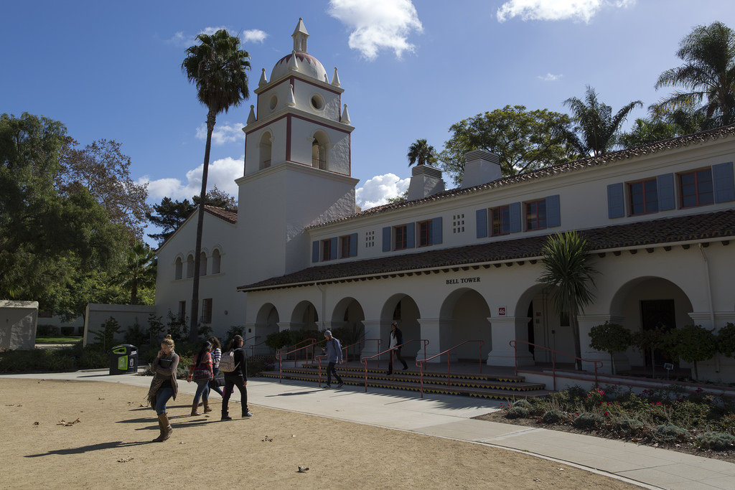
Academic Senate, 3/12/19
Intent to Raise Question

Slide 2
QUESTION
In the spirit of shared governance and respect, can the Provost create a taskforce of appropriate faculty or a forum of dialogue to address the question of Department oriented tenure-track searches versus the university’s long tradition of Interdisciplinary Recruitment that advances interdisciplinary student learning and faculty collaborations?
Frank Barajas
Academic Senate, 3.12.19
Intent to Raise Question

Slide 3
ANSWER
I envision this activity being a prime responsibility of the new AVP of Faculty Affairs position. I understand that it is an important issue, but I ask for your patience as we work to complete our leadership team
Provost Say
Academic Senate, 3.12.19
Intent to Raise Question

Slide 4
QUESTION
Is Provost Say intending to continue the use of search firms for the hiring of administrative positions? If so, can you express why you think they are important component to a successful search? Further, can you let us know how much the university spent on search firms in AY 17-18 and AY 18-19?
Matt Cook
Academic Senate, 3.12.19
Intent to Raise Question

Slide 5
ANSWER
I don’t have plans for any additional senior admin position during the rest of my term. Geoff had promised Education the use of a search firm if their search failed (which it recently did) and I will honor that promise. But there is nothing else on the horizon. That being said, there are times when a search firm makes sense, especially in very senior positions, because they tend to get better pools.
Provost Say
Academic Senate, 3.12.19
Intent to Raise Question

Slide 6
QUESTION
Over the past 6-8 months there have been significant personnel changes in the Provost's Office/Academic Affairs. A number of administrators have left their positions, others have been promoted, and a number of new people have been been hired -- whether permanently or as interims. For smooth and efficient operations, it would be helpful to have a widely shared and clearly defined understanding of which duties and responsibilities reside with which administrators and staff in Academic Affairs. In light of all the changes, could the Provost's Office share that current organizational understanding with the Academic Senate?
Jim Meriwether
Academic Senate, 3.12.19
Intent to Raise Question

Slide 7
ANSWER
In response to the question raised at the last Senate Meeting, the Division of Academic Affairs is working to update our organizational chart and to make this information public through our website. This will provide not only an overview to the structure of the division, but will also provide links to further information about the scope and responsibilities of all persons in the various offices.
Provost Say
Academic Senate, 3.12.19
Intent to Raise Question

Slide 8
QUESTION
I am hoping to see any evidence we have about post-graduation attainment/success of our graduates (Household income, job attainment, graduate school, etc.) and possibly get a presentation about it in an upcoming Senate meeting.
Sean Anderson
Academic Senate, 3.12.19
Intent to Raise Question

Slide 9
ANSWER
Yes, the CO just launched a website, which contains a dashboard specific to CI graduates. This dashboard is located at the following web address: https://calstatepays.org/#/
Genevieve Evans Taylor, Ed.D.
Academic Senate, 3.12.19
Intent to Raise Question

Slide 10
I currently have students who have DACA and undocumented status looking to apply for graduate school. In the past, due to the Ally training, students felt relatively safe divulging their status at either the Career Center the Graduate Studies Center (GSC).
a. With Martha Zavala from the Multicultural Dream Center and Aracely Flores from the GSC no longer on campus, what is CI doing to ensure our Dreamer students can plan for graduate school with a strong measure of ensured safety?
b. Can The Academic Senate please invite Martha’s replacement to speak about their role on campus?
c. Since all programs send students to graduate school, is there a plan to institutionalize the GSC so that Education does not have to bear the burden of the cost?
Brittnee Veldman
QUESTION
Academic Senate, 3.12.19
Intent to Raise Question

Slide 11
ANSWER
a. Martha Zavala served as the coordinator for our
Underrepresented Student Initiatives program (USI), which is housed within our Retention,
Outreach, and Inclusive Services area of the Division of Student Affairs. We recently filled this
position, and our new coordinator is Natalie Johnson. She is currently in the midst of her
onboarding process, but one of the main aspects of her job responsibilities is to continue the
work Martha had begun in supporting our DACA and Dreamer students. In addition to
continuing the faculty and staff ally training program, we have ongoing programming through
USI, Inclusive Student Services, and our Multi-cultural Dream Center. I would encourage faculty
to connect directly with Natalie, as well as Dr. Hiram Ramirez (Director of Inclusive Student
Services and the Multicultural Dream Center) and Dr. Charles Osiris (Associate Vice President of
Student Affairs – Retention, Outreach and Inclusive Services) to learn more and perhaps most
importantly, to discuss ways to actively collaborate to improve programming and support to our
students.
I cannot speak as to what is happening in the GSC, since this area is not within the purview of
the DSA. That being said, support for our Dreamer students is definitely a campus wide effort
that involves all administration, faculty, staff, and students, and I look forward to facilitating
more support and collaboration from the DSA.
Academic Senate, 3.12.19
Intent to Raise Question

Slide 12
ANSWER
b. Yes, of course. I’ve already discussed this with Dr. Osiris, as well as other faculty members who have inquired.
c. I cannot speak to this directly, as the GSC is not within the purview of the DSA. I would recommend that you start this discussion with your respective Dean and Provost.
Academic Senate, 3.12.19
Intent to Raise Question

Slide 13
QUESTION
In the last five years CAPS has faced several challenges that included: increased demand for services, reduced staffing, the training program being placed on hold, changes in leadership, and several campus and statewide related tragedies. Given these challenges, are counselor tenure positions going to be re-considered in order to provide greater stability and retention for faculty and for students?
Brittnee Veldman
Academic Senate, 3.12.19
Intent to Raise Question

Slide 14
ANSWER
Academic Senate, 3.12.19
Intent to Raise Question

Slide 15
QUESTION
The CI Boating Center is an incredible facility. It has potential to further our connection to Oxnard, and I encourage my colleagues to continue to think of innovative ways to utilize the space. Although we are able to reserve the classroom space at no cost, we are required to pay a $42 locksmith fee to unlock and lock the door. I’m concerned this fee might create an obstacle for certain groups or anyone who might be interested in utilizing the space. Is there a way to work with facilities or CI boating center staff to have that locksmith fee waived? Thank you for the consideration.
Luis Sanchez
Academic Senate, 3.12.19
Intent to Raise Question

Slide 16
NEW QUESTIONS???
Academic Senate, 3.12.19
Intent to Raise Question

